Slide 1
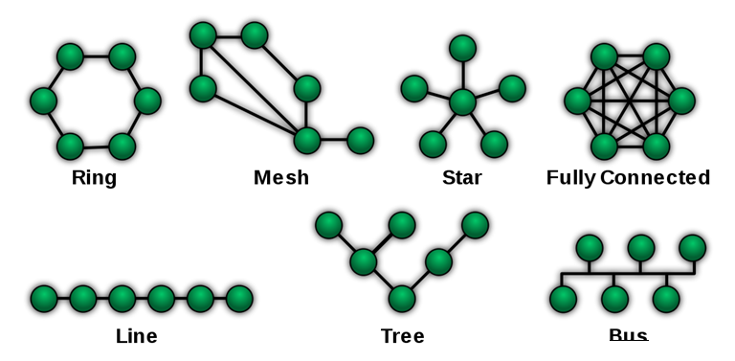
Graph Theory Introduction

Slide 2

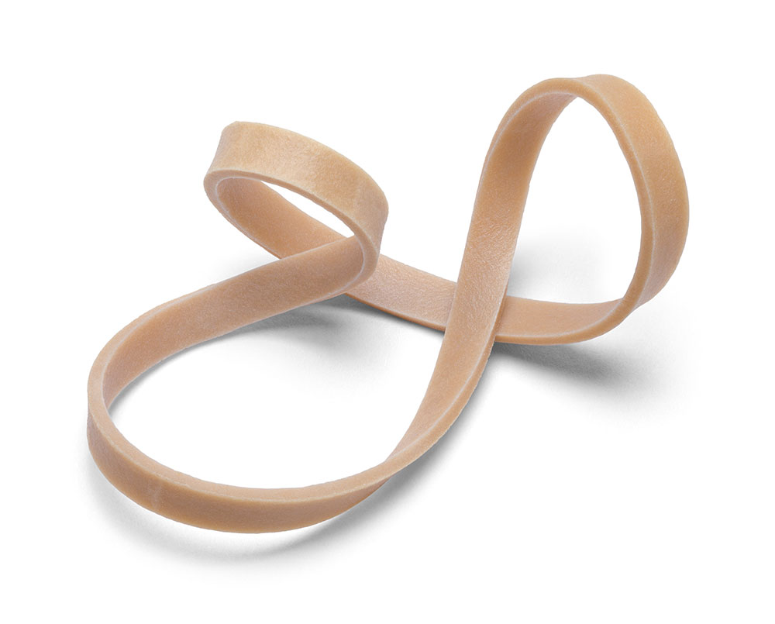
DO YOU THINK THEY ARE “SAME” IN SOME WAY?
COMMON: VERTEX = 4 and EDGE = 3
COULD WE INFER MORE?
SOMETHING COMMON?
COMMON: VERTEX - EDGE = 1
BUT WHY WE NEED LOOK FOR SOMETHING COMMON?

Slide 3
WHY WE NEED LOOK FOR SOMETHING COMMON?
COMMON & CLASSIFICATION
V - E < 1
V - E > 1
Connectivity: true
Connectivity: false
V - E = 1
Connectivity: true
E(V) = {1, 2}
E(V) = {1, 2, 3}
E(V) = {1, 2, 3, 4}

Slide 4
WHY WE NEED LOOK FOR SOMETHING COMMON?
COMMON & CLASSIFICATION
V - E < 1
V - E > 1
Connectivity: true
Connectivity: false
V - E = 1
Connectivity: true
E(V) = {1, 2}
E(V) = {1, 2, 3}
E(V) = {1, 2, 3, 4}

Slide 5
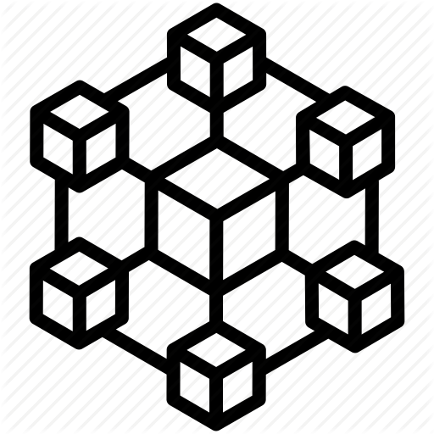
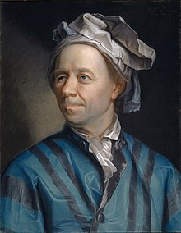
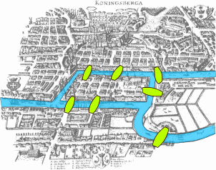
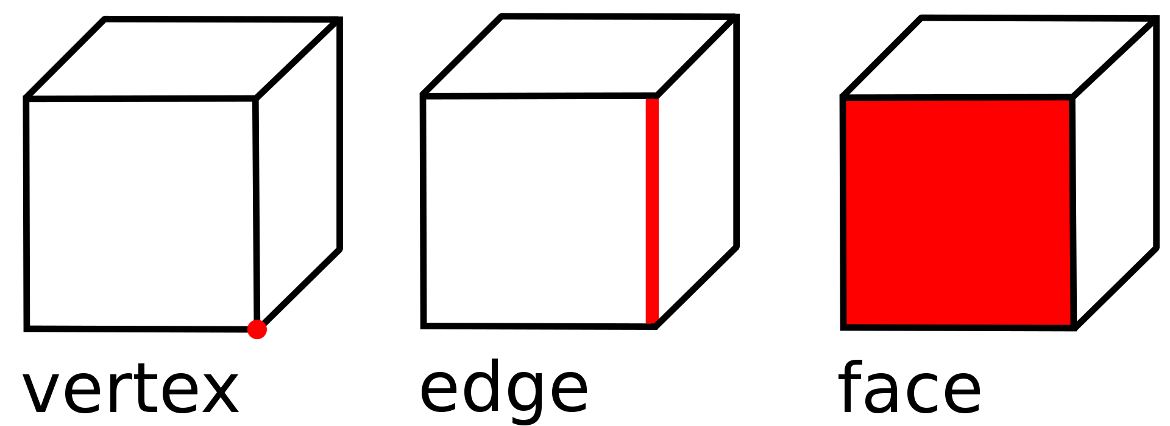
HISTORY
signaling the birth of topology
Leonhard Euler
Seven Bridges of Königsberg published in 1736
polyhedron formula, V − E + F = 2 published On 14 November 1750
the first paper in the history of graph theory

Slide 6
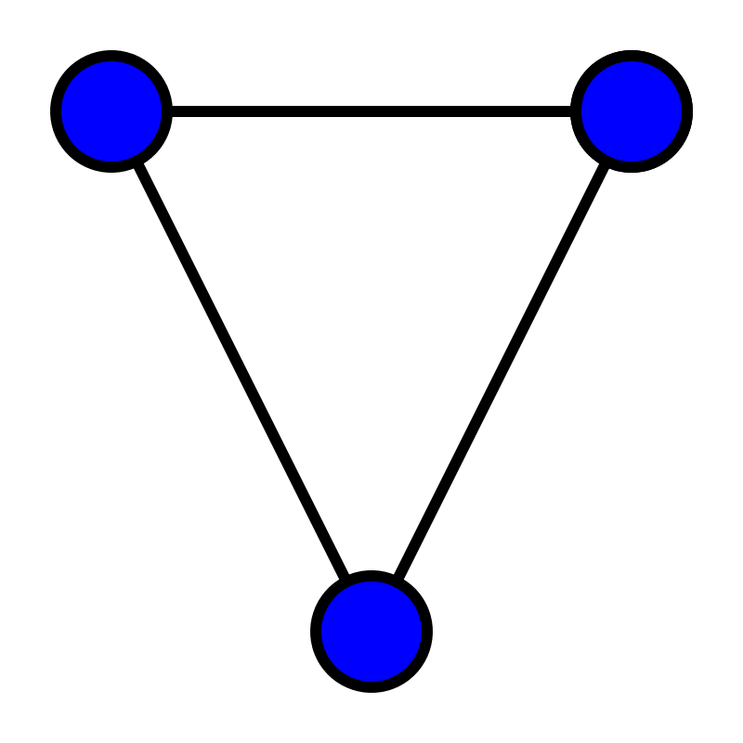
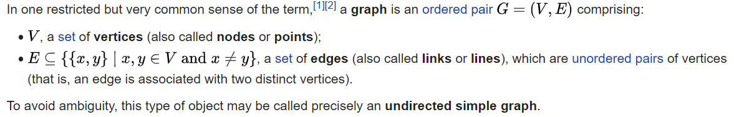
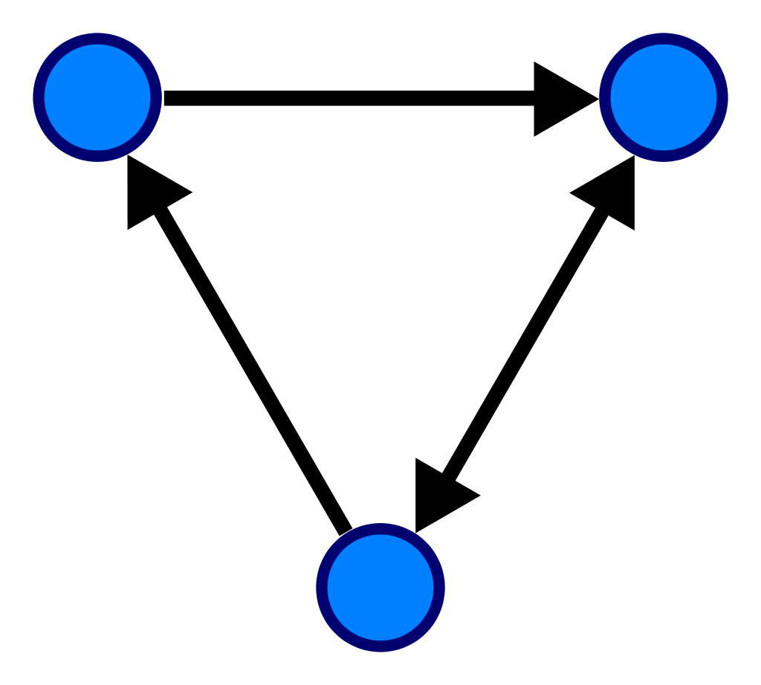
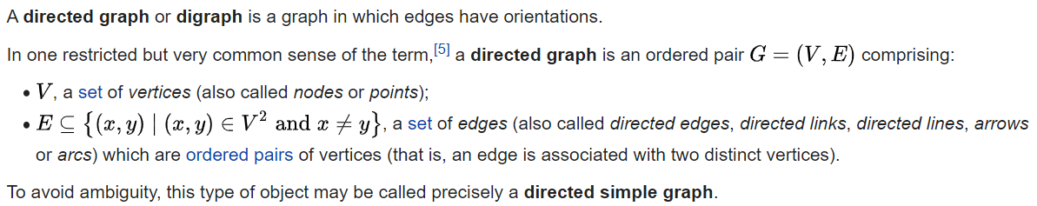
WHAT IS GRAPH THEORY
In mathematics, graph theory is the study of graphs, which are mathematical structures used to model pairwise relations between objects. A graph in this context is made up of vertices (also called nodes or points) which are connected by edges (also called links or lines). A distinction is made between undirected graphs, where edges link two vertices symmetrically, and directed graphs, where edges link two vertices asymmetrically. Graphs are one of the principal objects of study in discrete mathematics.

Slide 7
GRAPH THEORY vs TOPOLOGY
In the strict definitional sense, you can probably get all of graph theory expressed in the language of topology. But the flavors of the two fields are typically quite different.
if you happen upon a mathematician these days that considers herself a topologist, chances are she works either on something geometric, or very algebraic, and either way something pretty abstract.
On the other hand, if you happen upon a mathematician that considers herself a graph theorist, chances are she works on some pretty concrete objects, possibly with more obvious direct connections to real world applications.
Graph theory
Topology

Slide 8
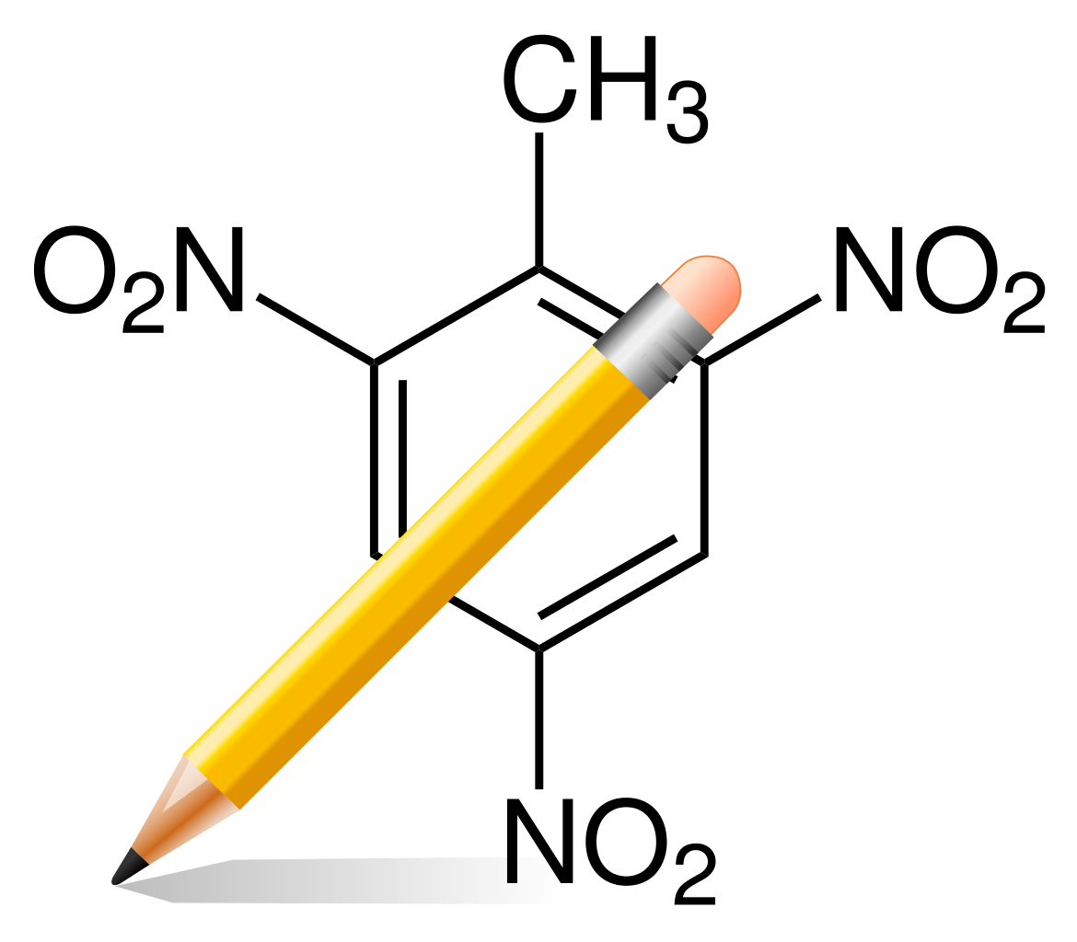





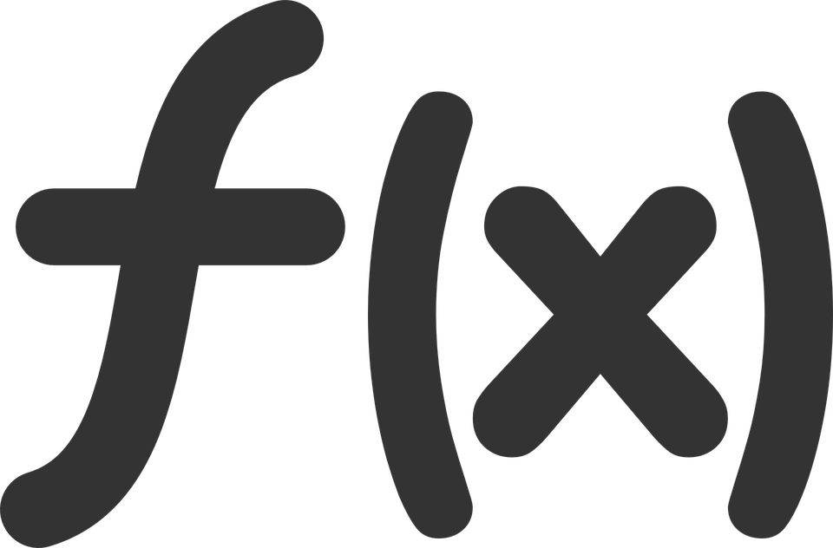
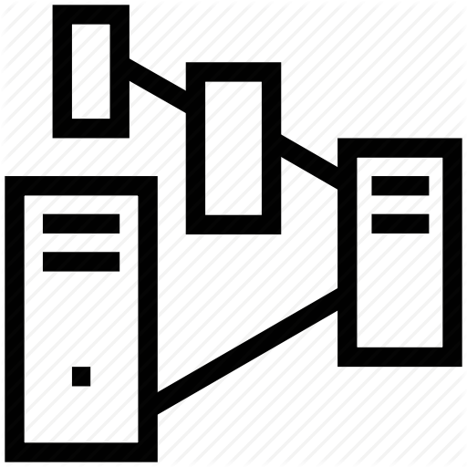
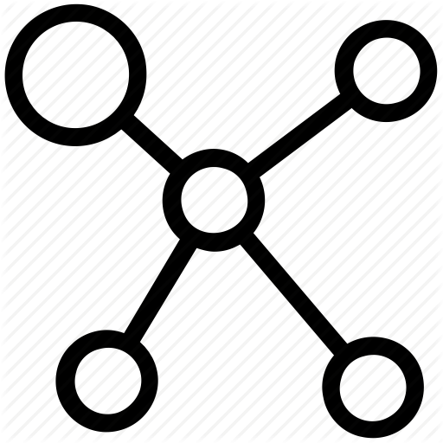

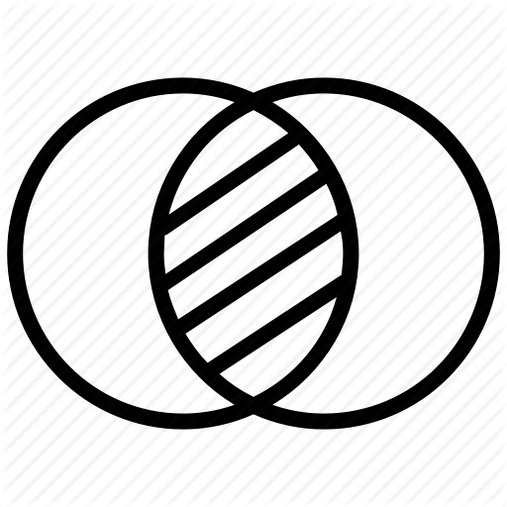
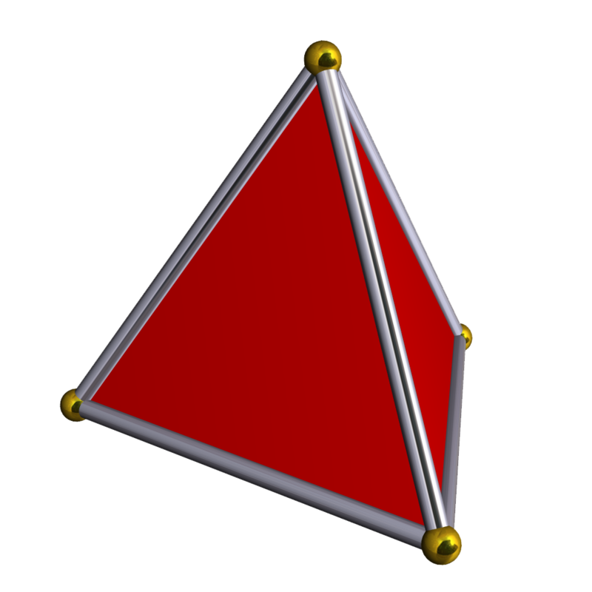

GRAPH THEORY vs TOPOLOGY - ZOOM OUT
Robotics
Chemics
Biology: molecules and nanostructure
Physics
Topology
Algebraic
Discrete mathematics
Graph Theory
Computer science and network
Set theory
Geometry
Mathematics
This Photo by Unknown Author is licensed under CC BY-SA

Slide 9
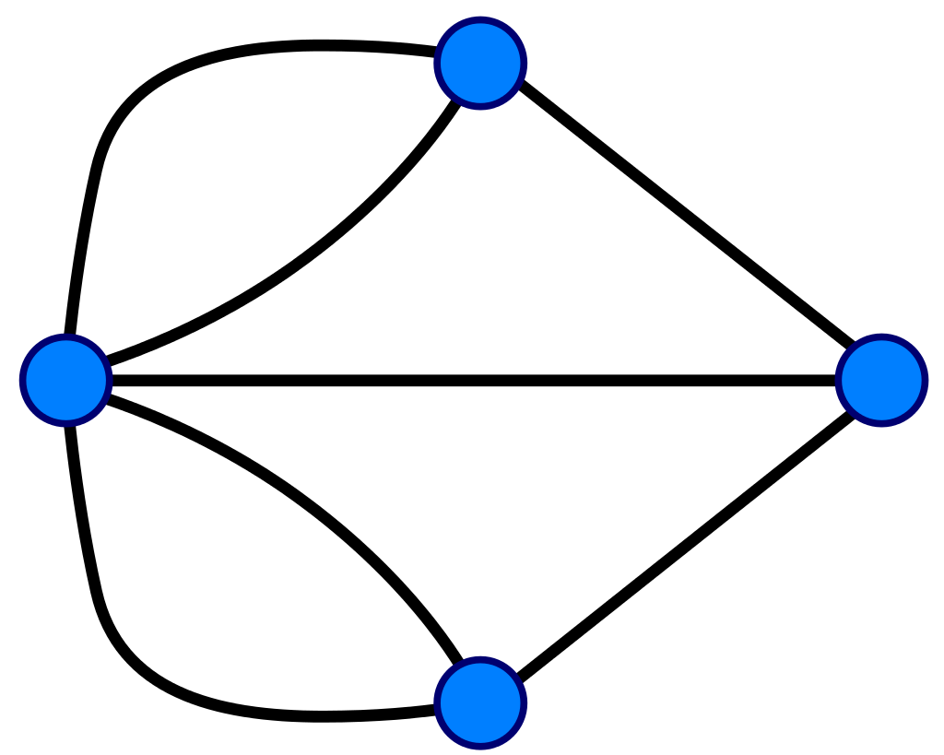
Eulerian path
In graph theory, an Eulerian trail (or Eulerian path) is a trail in a finite graph that visits every edge exactly once (allowing for revisiting vertices). Similarly, an Eulerian circuit or Eulerian cycle is an Eulerian trail that starts and ends on the same vertex. They were first discussed by Leonhard Euler while solving the famous Seven Bridges of Königsberg problem in 1736.
An undirected graph has an Eulerian cycle if and only if every vertex has even degree, and all of its vertices with nonzero degree belong to a single connected component.
An undirected graph can be decomposed into edge-disjoint cycles if and only if all of its vertices have even degree. So, a graph has an Eulerian cycle if and only if it can be decomposed into edge-disjoint cycles and its nonzero-degree vertices belong to a single connected component.
An undirected graph has an Eulerian trail if and only if exactly zero or two vertices have odd degree, and all of its vertices with nonzero degree belong to a single connected component.
5
2
E(V1)=3, V1 is odd degreed vertex
E(V2)=3, V2 is odd degreed vertex
E(V3)=3, V3 is odd degreed vertex
E(V4)=4, V4 is even degreed vertex
There are 3 odd degreed vertices, so no Eulerian trail.
4
1
4
2
1
6
3
7
3

Slide 10
APPLICATION – TREE AND BINARY TREE (ARBORESCENCES)
In computer science, a tree is a widely used abstract data type that simulates a hierarchical tree structure, with a root value and subtrees of children with a parent node, represented as a set of linked nodes.
A tree data structure can be defined recursively as a collection of nodes (starting at a root node), where each node is a data structure consisting of a value, together with a list of references to nodes (the "children"), with the constraints that no reference is duplicated, and none points to the root.
In computer science, a binary tree is a tree data structure in which each node has at most two children, which are referred to as the left child and the right child.
From a graph theory perspective, binary (and K-ary) trees as defined here are arborescences (In graph theory, an arborescence is a directed graph in which, for a vertex u called the root and any other vertex v, there is exactly one directed path from u to v. An arborescence is thus the directed-graph form of a rooted tree, understood here as an undirected graph.).

Slide 11
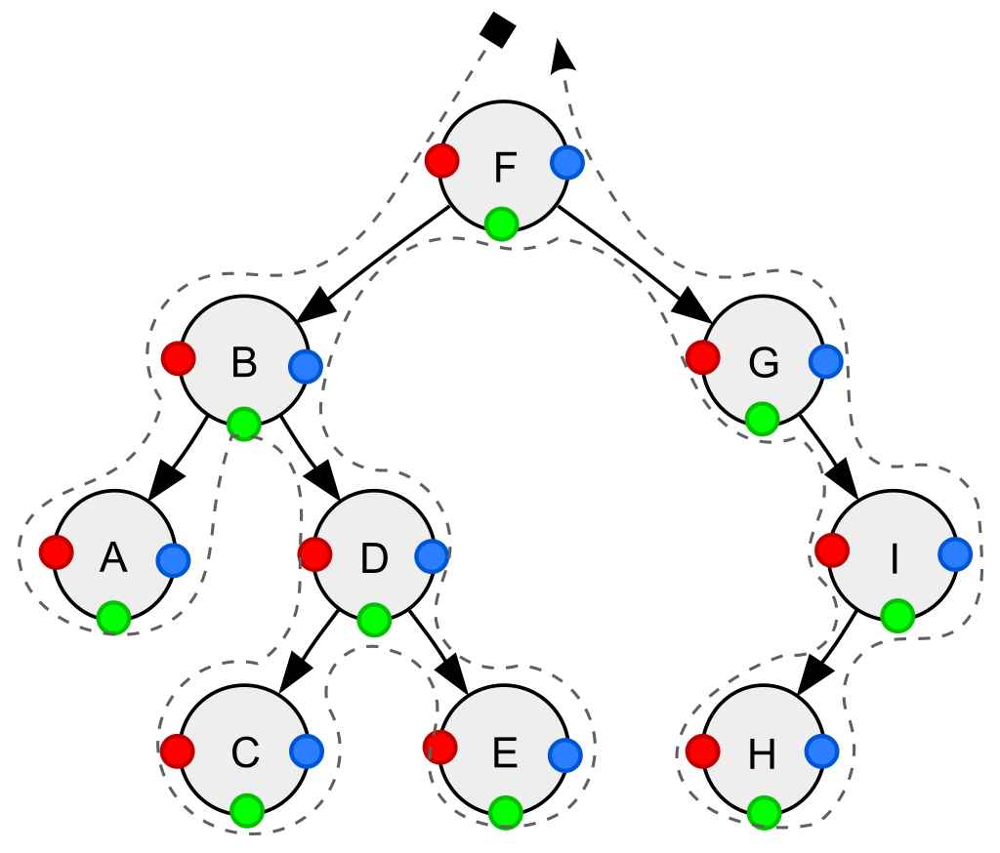
APPLICATION – TREE TRAVERSAL
TREE TRAVERSAL:
Pre-order: Node -> Left -> Right
In-order: Left -> Node -> Right
Post-order: Left -> Right -> Node
Depth-first traversal (dotted path) of a binary tree:
Pre-order (node access at position red ●): F, B, A, D, C, E, G, I, H;
In-order (node access at position green ●): A, B, C, D, E, F, G, H, I;
Post-order (node access at position blue ●): A, C, E, D, B, H, I, G, F.

Slide 12

APPLICATION – BUBBLE SORTING
7 2 6 4 1 8 3 5 9
2 7 6 4 1 8 3 5 9
2 7 6 4 1 8 3 5 9
2 7 6 4 1 8 3 5 9
2 7 6 4 1 8 3 5 9
1 7 6 4 2 8 3 5 9
1 7 6 4 2 8 3 5 9
1 7 6 4 2 8 3 5 9
1 7 6 4 2 8 3 5 9
1 7 6 4 2 8 3 5 9
The min object is now in the head

Slide 13
APPLICATION – BUBBLE SORTING
1 7 6 4 2 8 3 5 9
1 6 7 4 2 8 3 5 9
1 6 7 4 2 8 3 5 9
1 4 7 6 2 8 3 5 9
1 4 7 6 2 8 3 5 9
1 2 7 6 4 8 3 5 9
1 2 7 6 4 8 3 5 9
1 2 7 6 4 8 3 5 9
1 2 7 6 4 8 3 5 9
1 2 7 6 4 8 3 5 9
The min object is now in the head

Slide 14
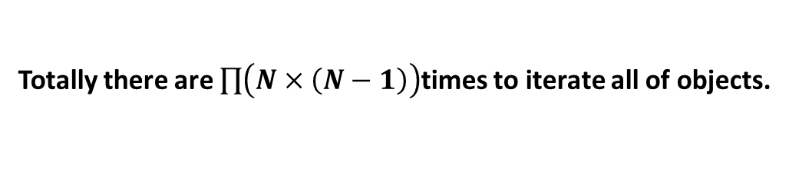
APPLICATION – BUBBLE SORTING
1 2 7 6 4 8 3 5 9
1 2 6 7 4 8 3 5 9
1 2 6 7 4 8 3 5 9
1 2 4 7 6 8 3 5 9
1 2 4 7 6 8 3 5 9
1 2 4 7 6 8 3 5 9
1 2 3 7 6 8 4 5 9
1 2 3 7 6 8 4 5 9
1 2 3 7 6 8 4 5 9
The min object is now in the head
Totally there are $\prod{\left(N×\left(N−1\right)\right)}$times to iterate all of objects.

Slide 15
APPLICATION – BINARY TREE SORTING
7 2 6 4 1 8 3 5 9
7
2
8
1
6
9
4
3
5
In-order traversal: 1, 2, 3, 4, 5, 6, 7, 8, 9

Slide 16
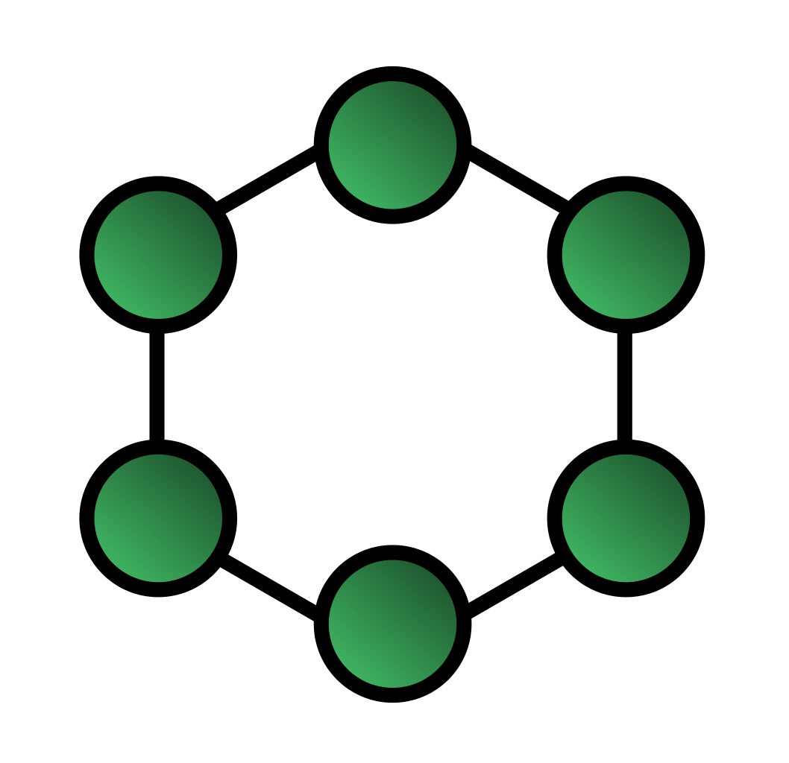

APPLICATION: RING NETWORK TOPOLOGY
Token Ring (IEEE 802.5), topology: ring
I am listening
I am listening
I have the token, and only I can speak, others should listen.
I am listening
This Photo by Unknown Author is licensed under CC BY-SA

Slide 17
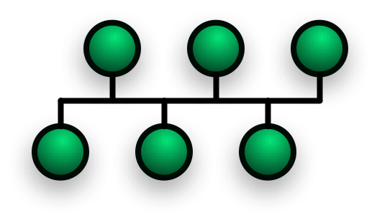



APPLICATION: BUS NETWORK TOPOLOGY
Ethernet (IEEE 802.3), topology: bus
CSMA/CD: Carrier-sense multiple access with collision detection
I speak
I speak
Collision
I am waiting for a random time
I am waiting for a random time
I speak
I speak
This Photo by Unknown Author is licensed under CC BY-SA

Slide 18
APPLICATION: BUS NETWORK TOPOLOGY
Ethernet (IEEE 802.3), topology: bus
CSMA/CD: Carrier-sense multiple access with collision detection
This Photo by Unknown Author is licensed under CC BY-SA

Slide 19
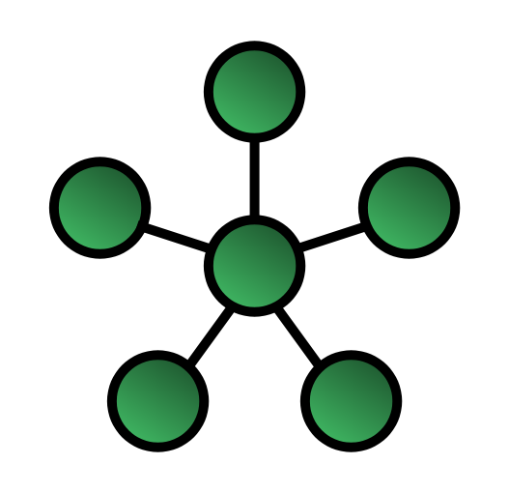

APPLICATION: STAR NETWORK TOPOLOGY
Ethernet, topology: star

Slide 20


Questions and Answers

